Slide 1

Mythbusters 2
Cable Myths
Tim Stronge & Alan Mauldin
TeleGeography

Slide 2
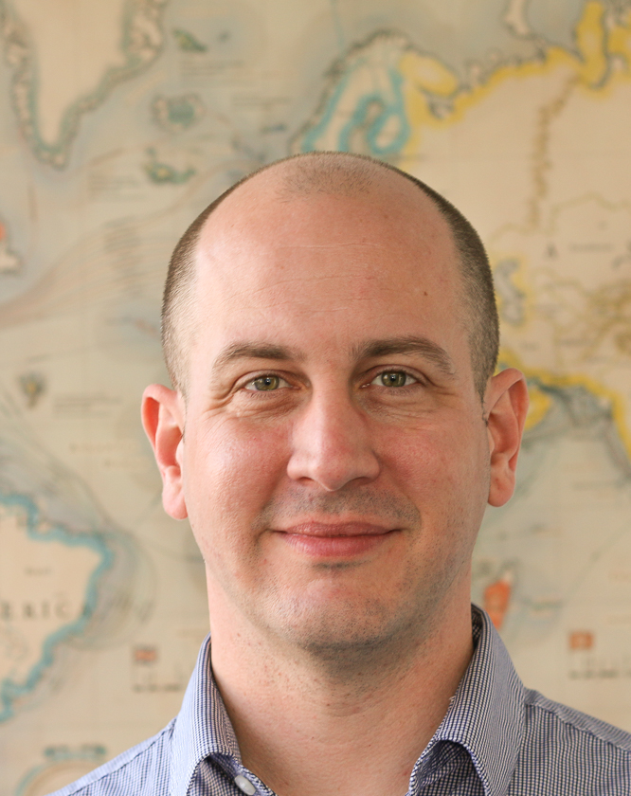
Presenter Profile
Since joining the company in 2000, Mr. Mauldin has served as a principal analyst in many areas of TeleGeography’s research, including international Internet infrastructure, submarine cable systems, and bandwidth demand modeling.
Alan made the Kessel run in less than 12 parsecs.
Contents
Alan Mauldin
Research Director
amauldin@telegeography.com

Slide 3
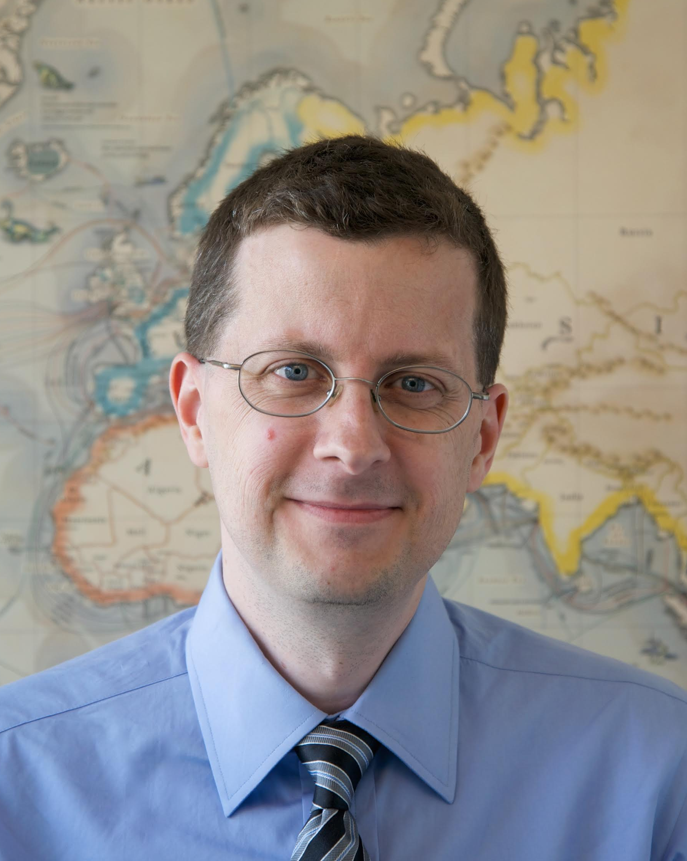
Presenter Profile
Since joining TeleGeography in 1996, Tim has served as a principal analyst in most areas of research, including network infrastructure, bandwidth demand modeling, cross-border traffic flows, and telecom services pricing.
Tim has the death sentence on 12 star systems.
Contents
Tim Stronge
VP—Research
tstronge@telegeography.com

Slide 4
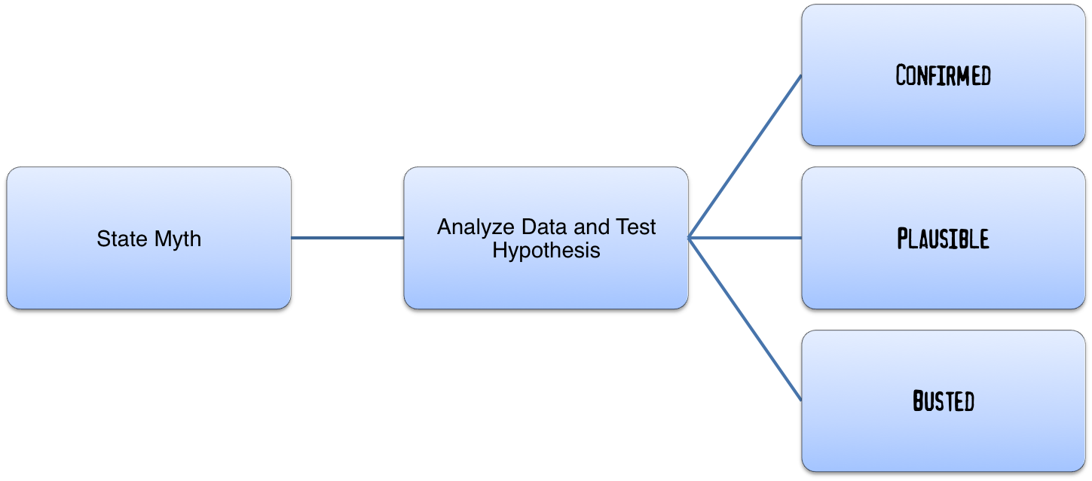
Revenge of the Cable Myths
What is mythbusting?

Slide 5
Revenge of the Cable Myths
Industry myths to be tested
Cables that avoid U.S. territory are free from mass surveillance
Internet providers around the world have become less reliant on the U.S. as a result of the Snowden revelations
Sharks pose the greatest danger to undersea cable infrastructure
Demand for submarine cable capacity is doubling every 2 years
Content providers need fiber pairs everywhere
2010 Trans-Atlantic Paper Retrospective

Slide 6
Revenge of the Cable Myths
Industry myths to be tested
The global network has never been more resilient
Netflix has huge subsea capacity requirements
The destruction of a single satellite would cause half of North America to “lose their Facebook”
Energy costs are driving build decisions of data centers (and therefore networks)
The problem of multiple parties attempting to build on the same (or similar) path is unique to the subsea industry
“Adult” content drives most Internet traffic

Slide 7
Energy Costs Myth
The Myth: Energy costs are driving build decisions of data centers (and therefore networks)
Conclusion: ???
Status: ???

Slide 8
Who’s in Charge Here?
Cost of 120 MW Data Center
Cost of Trans-Oceanic Sub Cable
$770m
$250m

Slide 9
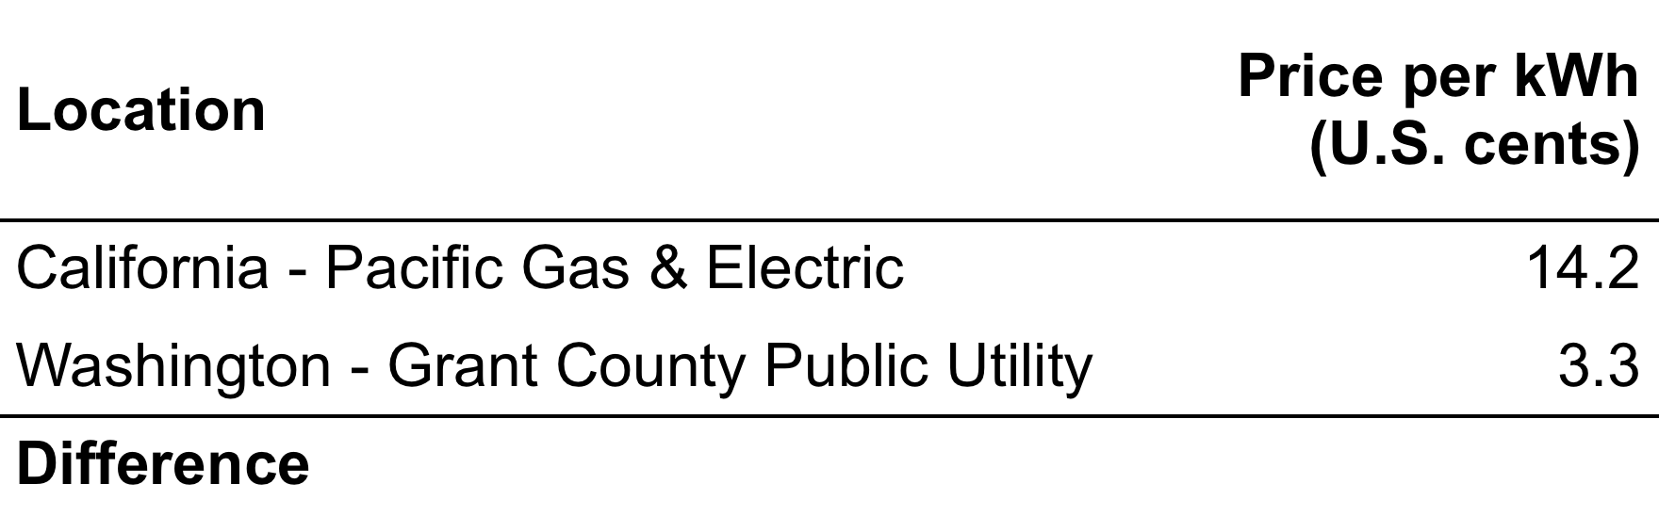
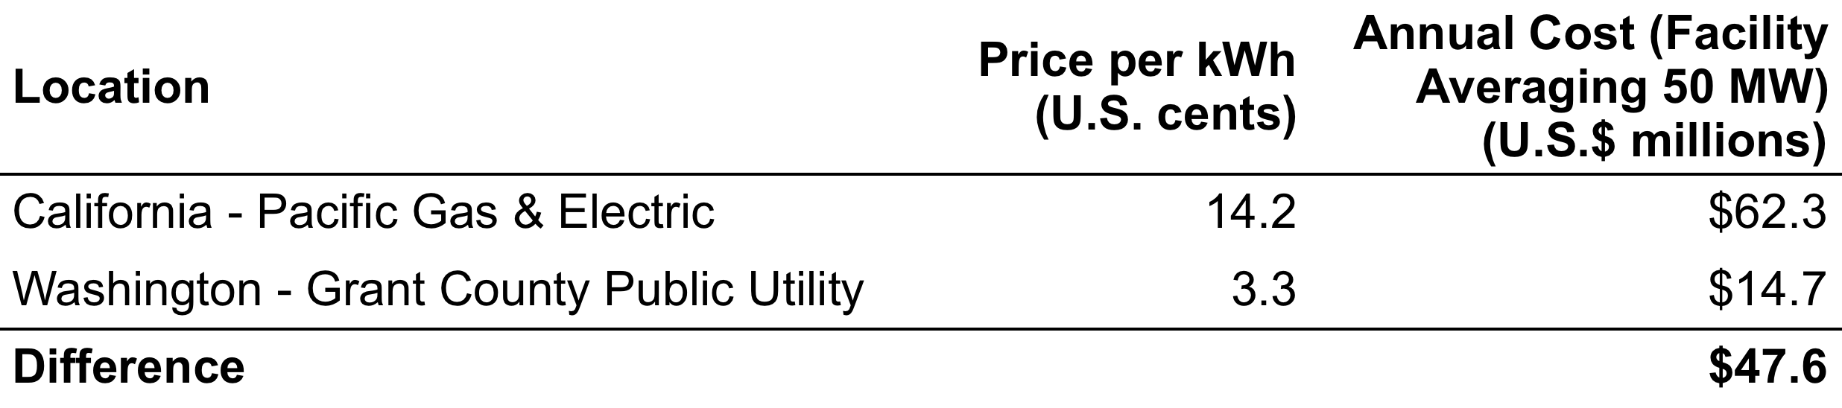
Location Matters
Industrial Power Rates, California vs. Washington State
Source: U.S. Energy Information Administration (electricity prices)
Notes:
Grant County / Quincy WA
* two hydro dams in Grant County
* enterprise data centers: Microsoft, Dell, Yahoo! and Intuit
* wholesale data centers: Sabey and Vantage
* even bitcoin mining locating to Quincy (!!!!). Building out 2.5 MW capacity there. They're in the Dell facility:

Slide 10
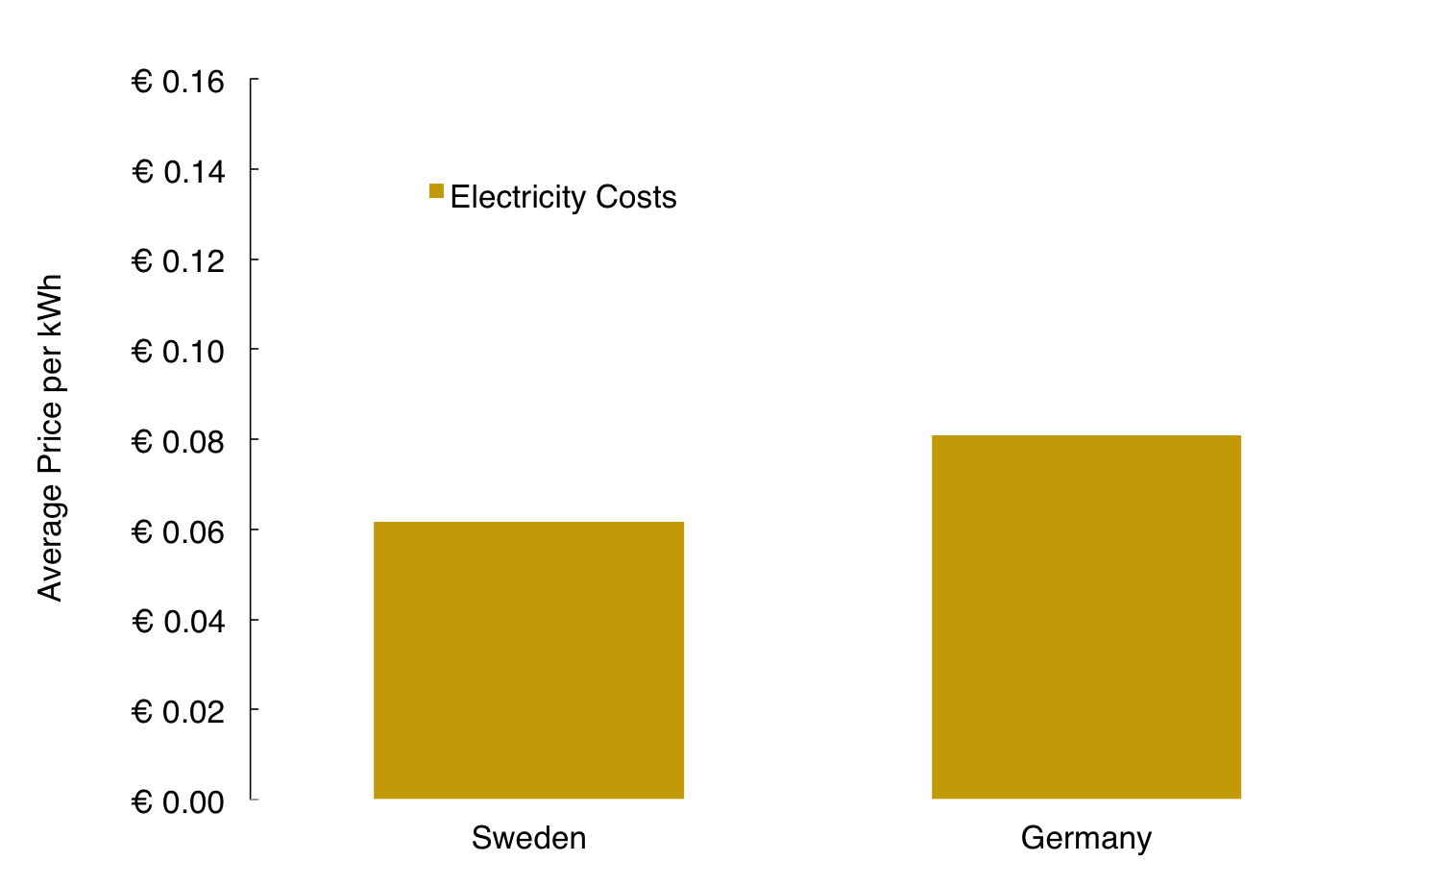
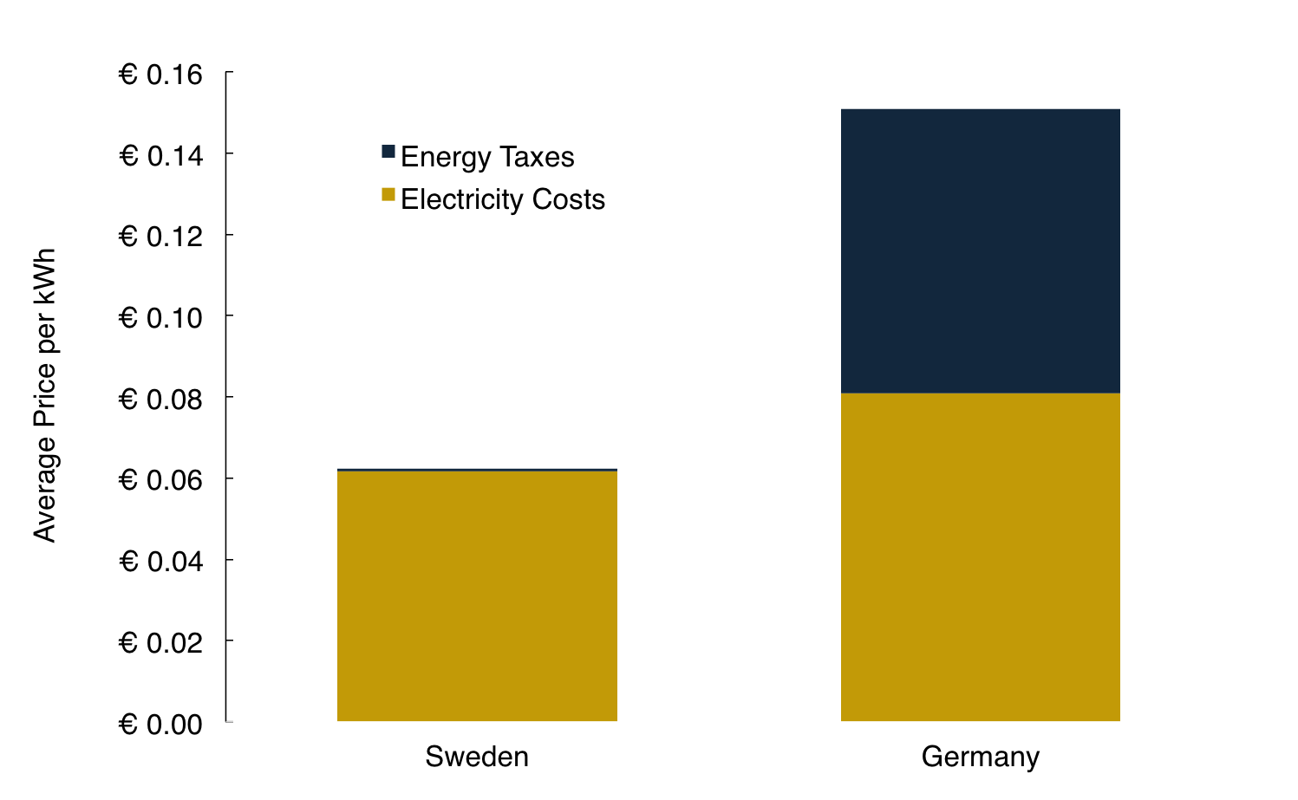
Taxes Also Matter
Average Electricity Price for Industry, Sweden vs. Germany
Source: Eurostat
Notes:
That’s electricity tax.
Local tax incentives are also important: real estate and sales tax. (Sales tax important because of all the IT equipment installed.) Those are governed at the local and state levels in the USA, and often there are big incentives. For buildout of a small (5 MW facility), these taxes avg. $23m in the USA, according to CBRE.
On average, CBRE reports, taxes account for about 8.7 percent of data centers' total cost. In the Portland market, taxes are just 2.7 percent. Only Omaha, Nebraska, rates better. CBRE finds Omaha is extraordinarily "aggressive" in recruiting data centers, levying no taxes whatsoever on them.
Facebook has spent nearly $800 million since 2010 to build and equip two giant data warehouses on the hill above Prineville. It spends another $12 million a year to power and cool all those computers. Work begins this fall on a third data center, Oregon's biggest, 40 percent larger than the last.
... For this, Facebook won property tax exemptions that cover its land, buildings and – most importantly – computers. The breaks saved the company $30 million the last two years alone, and those savings will balloon when the third data center opens.

Slide 11

Energy Costs Myth
The Myth: Energy costs are driving build decisions of data centers (and therefore networks)
Conclusion: Lots of drivers for determining locations of content provider data centers; energy source and costs are primary ones
Status:
Notes:
Lots of factors:
Local tax breaks. CBRE estimates that local/state taxes = avg. 8.7% enterprise data center costs in the USA. But only 2.7% in Oregon cause of tax breaks.
Availability of green energy (wind, hydro, geothermal)
Climate (cool is better)
Cost of land
Construction costs
And, yes, network availability. But networks are down the list.

Slide 12
Funding Myth
The Myth: The problem of multiple parties attempting to build on the same (or similar) path is unique to the subsea industry.
Conclusion: ???
Status: ???

Slide 13


Funding Myth: “Twin Films”
1997

Slide 14


Funding Myth: “Twin Films”
1998
Notes:
1998 was a particularly bad year for this phenomenon.

Slide 15


Funding Myth: “Twin Films”
1998

Slide 16


Funding Myth: “Twin Films”
1998

Slide 17


Funding Myth: “Twin Films”
1995

Slide 18


Funding Myth: “Twin Films”
2003/04

Slide 19


Funding Myth: “Twin Films”
1993/94

Slide 20


Funding Myth: “Twin Films”
1992

Slide 21


Funding Myth: “Twin Films”
1995

Slide 22


Funding Myth: “Twin Films”
2000

Slide 23


Funding Myth: “Twin Films”
2005/06
Notes:
“Serious” films also affected.

Slide 24


Funding Myth: “Twin Films”
2013

Slide 25


Funding Myth: “Twin Films”
1989
Notes:
Not a new phenomenon.

Slide 26


Funding Myth: “Twin Films”
1986

Slide 27


Funding Myth: “Twin Films”
1940

Slide 28


“Multiple Discovery”
Development of calculus (1670s)
Notes:
Commonly cited examples of multiple independent discovery are the 17th-century independent formulation of calculus by Isaac Newton, Gottfried Wilhelm Leibniz and others, described by A. Rupert Hall;[5] the 18th-century discovery of oxygen by Carl Wilhelm Scheele, Joseph Priestley, Antoine Lavoisier and others; and the theory of evolution of species, independently advanced in the 19th century by Charles Darwin and Alfred Russel Wallace.

Slide 29
Funding Myth
Why does “Multiple Discovery” happen?
No one is certain, but lots of theories:
  Recombinant conceptualization
  Company-to-company staff movement
  Industrial espionage
Notes:
The concept of multiple discovery (also known as simultaneous invention)[1] is the hypothesis that most scientific discoveries and inventions are made independently and more or less simultaneously by multiple scientists and inventors.[2] The concept of multiple discovery opposes a traditional view—the "heroic theory" of invention and discovery.
Recombinant DNA = general name for a piece of DNA that has been created by the combination of at least two strands.
Recombinant conceptualization = a new concept arises through the crossing of pre-existing concepts and facts.

Slide 30
Funding Myth
“Multiple Discovery” and the transport industry
Market confusion
Good business plans delayed because funding becomes much more difficult:
  Customers don't know where to place their bets for pre-sales
    Result: harder to hit funding targets for CIF
  Customers often try to leverage potential cables off each other
    Result: price destruction

Slide 31

Funding Myth
The Myth: The problem of multiple parties attempting to build on the same (or similar) path is unique to the subsea industry.
Conclusion: The stakes are higher in the subsea sector, but “multiple discovery” is a problem in many industries.
Status: ???

Slide 32
Adult Traffic Myth
The Myth: “Adult” content drives most Internet traffic
Conclusion: ???
Status: ???

Slide 33
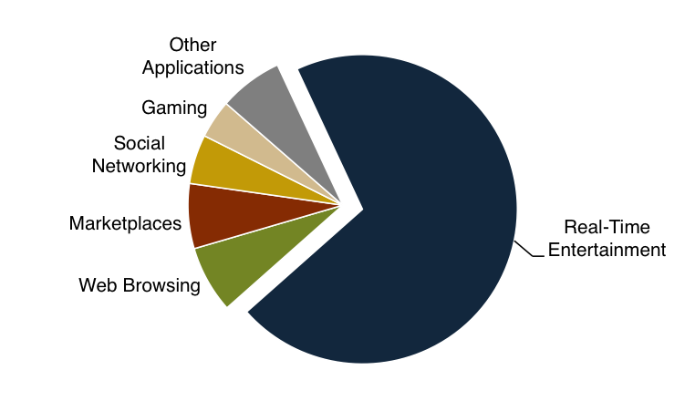
Adult Traffic Myth
Peak Downstream Traffic by Application, North America
Source: Sandvine Global Internet Phenomena, 2015
Notes:
70.4% of traffic is “real-time entertainment” (i.e., video and audio streaming) … myth looking good so far!

Slide 34
Single-Site Data, 2015
Largest adult site = 75 GB per second streamed (source: Pornhub)
Overall Internet = ca. 20 TB per second
Largest adult site = 0.375% of overall Internet
Notes:
Source: http://www.pornhub.com/insights/pornhub-2015-year-in-review
Pornhub ranks #2 overall website visitors among adult sites according to Alexa. Pornhub is globally #61 site according to Alexa in 2016. Xvideos.com was #51. But Pornhub has a ton of affiliate sites that are probably counted in their traffic total.

Slide 35
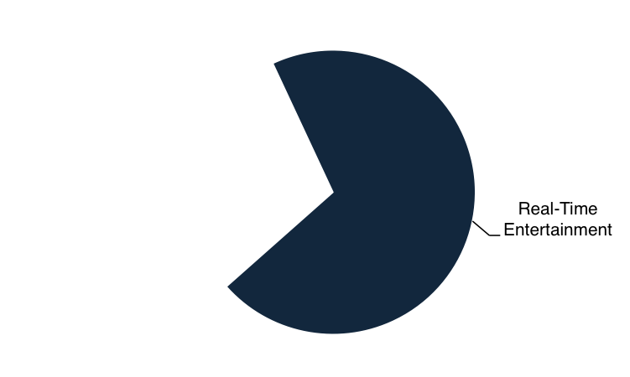
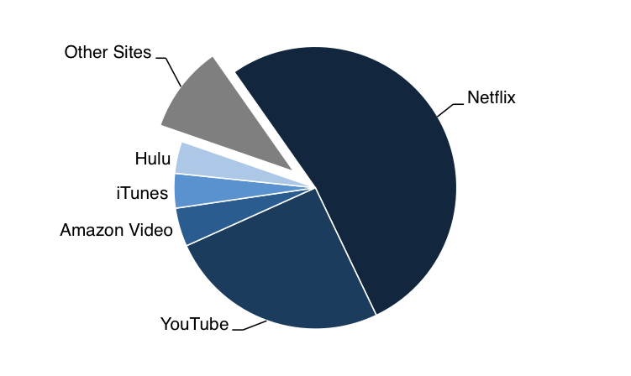
Adult Traffic Myth
Real-Time Entertainment Peak Downstream Traffic by Application, North America
Source: Sandvine Global Internet Phenomena, 2015
Notes:
Other sites = 10% of real-time entertainment. Thus, only 7% overall.
And that includes lots of non-adult content (Twitch, Pandora, Spotify, etc.).
Just a guess, but porn probably no bigger than 2-3% overall downstream traffic.

Slide 36
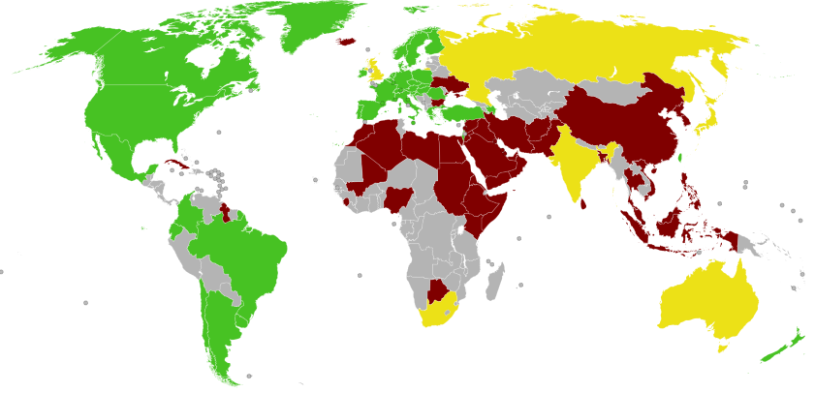
Adult Content Not Legal Everywhere …
Green = legal
Yellow = some restrictions
Red = illegal
Source: Wikipedia

Slide 37
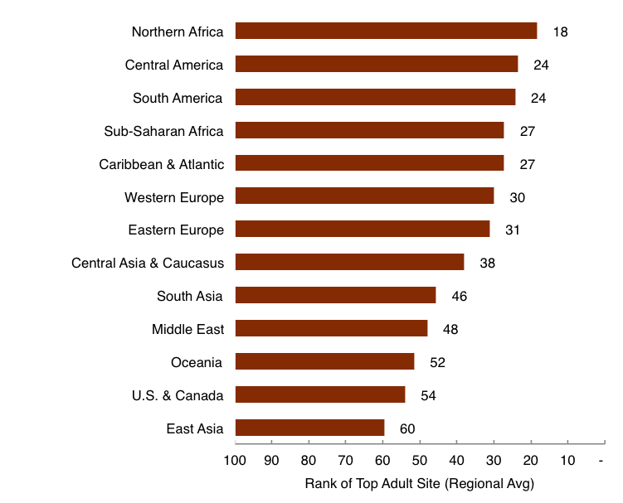
… But Nevertheless Ubiquitous
Highest Rank of Adult Site (Regional Average)
Source: Alexa

Slide 38
Adult Content Big on Some Routes
Top 20 European Sites Serving South America
Site Category | Number of Sites
Adult | 5
Pop Ups | 5
Shopping | 2
Social Networking | 2
Computer | 2
Sports | 1
Torrent | 1
Travel | 1
Other | 1
Subtotal | 20
Source: Alexa (site rankings), TeleGeography (server location analysis)
Notes:
Half of the top European sites serving computers in South America are either porn or pop-up ads.
Porn is probably a higher proportion of international traffic than total (end-user) traffic. That’s because it tends to be served from the U.S. or western Europe – but consumed everywhere. Different than Netflix, which has cache locations in lots of countries.
MindGeek (parent of PornHub) says they use 2 different CDNs and serve from North America and Europe.

Slide 39
Adult Traffic Myth
The Myth: “Adult” content drives most Internet traffic
Conclusion: Adult content = small sliver of Internet
Status: ???

Slide 40

A Palette Cleanser

Slide 41


Slide 42

Revenge of the Cable Myths
Industry myths to be tested
Cables that avoid U.S. territory are free from mass surveillance
Internet providers around the world have become less reliant on the U.S. as a result of the Snowden revelations
Sharks pose the greatest danger to undersea cable infrastructure
Demand for submarine cable capacity is doubling every 2 years.
Content providers need fiber pairs everywhere
2010 Trans-Atlantic Paper Retrospective

Slide 43
Revenge of the Cable Myths
Industry myths to be tested
The global network has never been more resilient
Netflix has huge subsea capacity requirements
The destruction of a single satellite would cause half of North America to “lose their Facebook”
Energy costs are driving build decisions of data centers (and therefore networks)
The problem of multiple parties attempting to build on the same (or similar) path is unique to the subsea industry
“Adult” content drives most Internet traffic

